Slide 1
The (post-quantum) future of data privacy
Cecilia Boschini, Predoctoral Researcher
IBM Research – Zurich
October 4th, 2018

Slide 2
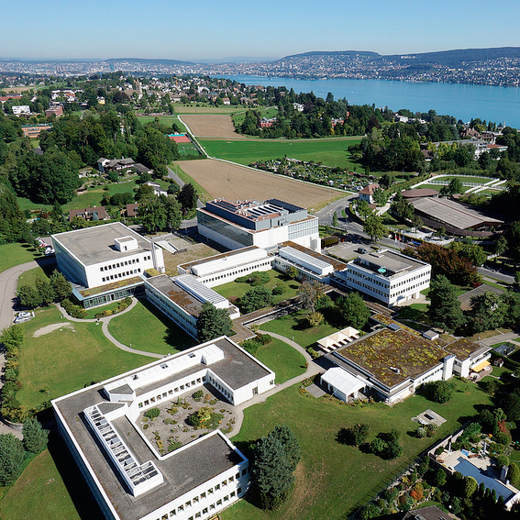
IBM Research - Zurich
Established in 1956
45+ different nationalities
Two Nobel Prizes:
1986: Nobel Prize in Physics for the invention of the scanning tunneling microscope by Heinrich Rohrer and Gerd K. Binnig
1987: Nobel Prize in Physics for the discovery of high-temperature superconductivity by K. Alex Müller and J. Georg Bednorz
Binnig and Rohrer Nanotechnology Centre opened in 2011 (Public Private Partnership with ETH Zürich and EMPA)

Slide 3
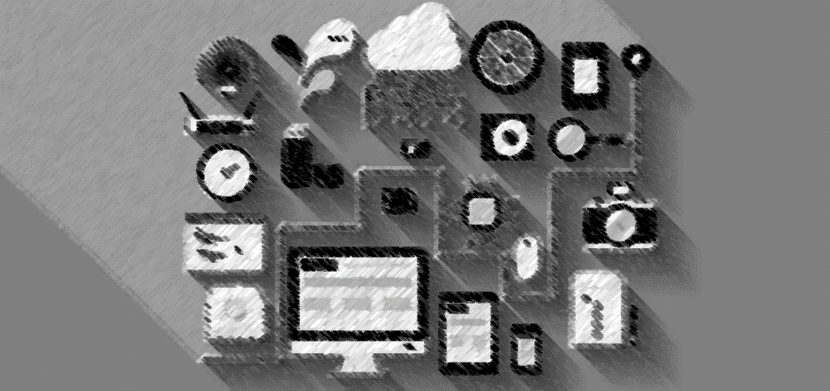

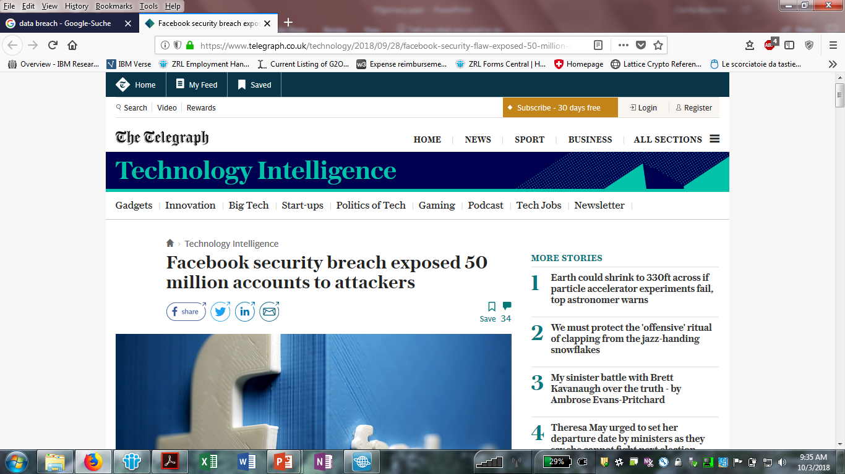
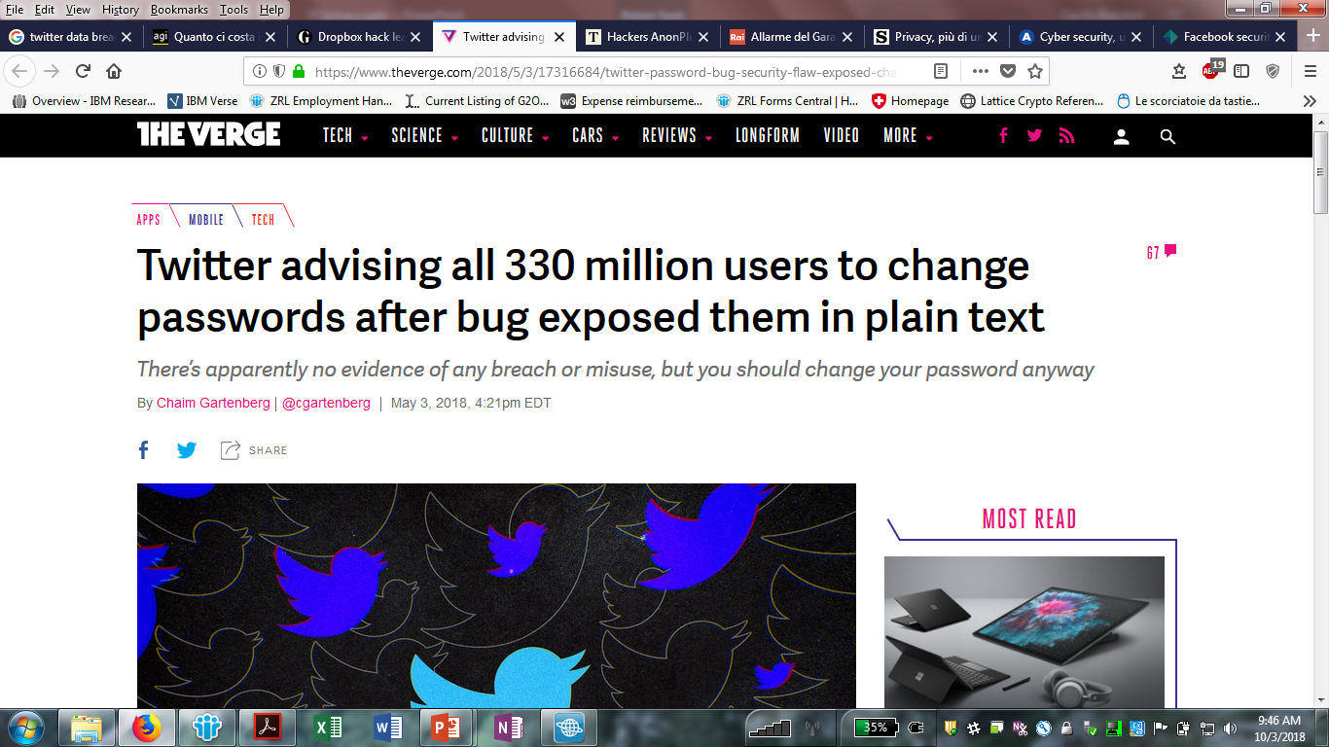
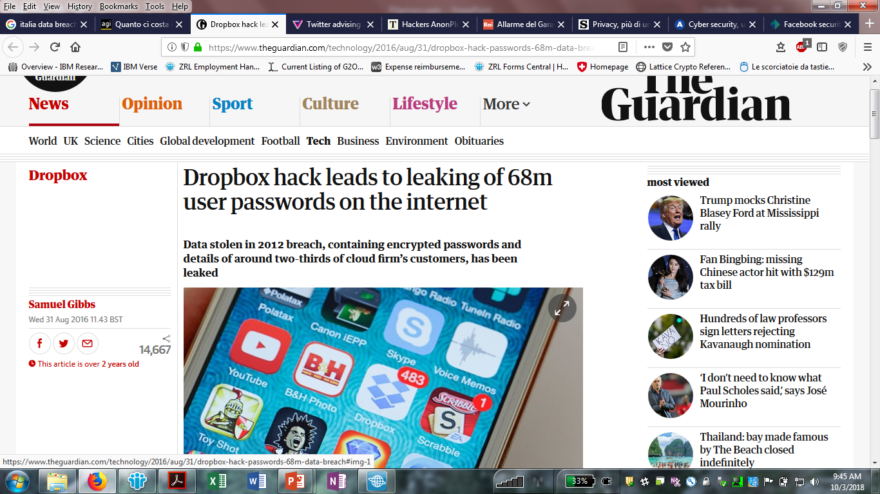
Notes:
50 million Facebook users have been exposed to ID fraud after the biggest cyber attack on the social media giant in its history.
The company revealed that hackers were able to access accounts on an unprecedented scale due to a security hole that had remained open for more than a year.
Facebook said it had alerted the FBI over the breach, and security experts said a rogue state such as Russia may have been responsible.
The cyber defence arm of GCHQ said it was investigating the hack, which allowed attackers full access to private Facebook profiles, and advised British users to be on the lookout for fraud.
Facebook was facing questions about why it had taken almost two weeks to shut the security hole after noticing “unusual traffic” on its systems in mid-September.
(28sept2018)
TWITTER:
According to Twitter, the bug occurred due to an issue in the hashing process that masks passwords by replacing them with a random string of characters that get stored on Twitter’s system. But due to an error with the system, apparently passwords were being saved in plain text to an internal log, instead of masking them with the hashing process. Twitter claims to have found the bug on its own and removed the passwords. It’s working to make sure that similar issues don’t come up again.

Slide 4


How to guarantee privacy? Minimize!
Zero-Knowledge proofs
Allow to prove knowledge of a secret without revealing it.
Applications in a lot of different scenarios (example: authentication).
Can be interactive or non interactive.

Slide 5





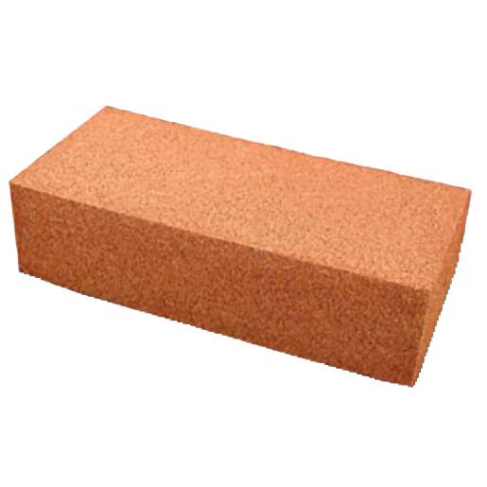
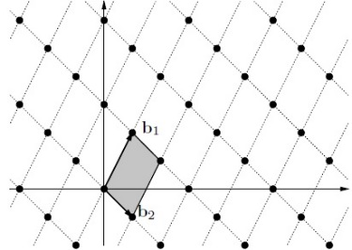
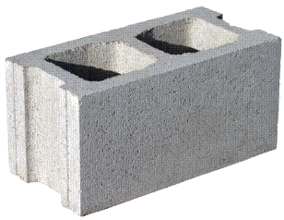
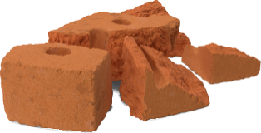



Privacy in the Quantum World
IDEA: substitute the problem with a new math problem
that is hard to solve for a quantum computer!
Breaking the scheme = solving the hard problem
The adversary cannot break the scheme because it cannot solve the problem!
Security proof
Hard Math
Problem
Cryptographic
scheme
Post-quantum
Cryptography
Lattice-based
Cryptography

Slide 6











Attribute-based Tokens over lattices
Security requirement:
Impossible to forge the issuer’s signature.
Cecilia Boschini, Jan Camenisch, Gregory Neven, Relaxed lattice-based signatures with short zero-knowledge proofs, Proceedings of International Conference on Information Security, 2018.

Slide 7



Anonymous Attribute-based Tokens over lattices
Security requirement:
Impossible to forge the issuer’s signature.
+
Unlinkability and no impersonation attacks when the verifier (Alice) is corrupted.
Cecilia Boschini, Jan Camenisch, Gregory Neven, Relaxed lattice-based signatures with short zero-knowledge proofs, Proceedings of International Conference on Information Security, 2018.

Slide 8
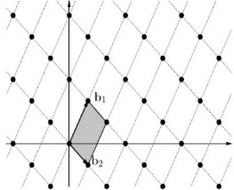
A Crash Course on Lattices
Lattice = grid of points
A lattice is identified by a basis.
Finding a “good” basis given a random lattice basis is hard.
If I know a particularly “good” basis, I can find a short vector. Otherwise, finding a short vector in the lattice is a hard problem.

Slide 9





Intuition behind AAT over lattices
The issuer’s signature is a short vector in the lattice dependent on the user’s id and attributes, and on the issuer’s pk.
Unforgeable if it is hard
to find a short vector in
the lattice!
Only a minimal amount of data is revealed to
Alice!
Cecilia Boschini, Jan Camenisch, Gregory Neven, Relaxed lattice-based signatures with short zero-knowledge proofs, Proceedings of International Conference on Information Security, 2018.
Notes:
Signature: short vector from lattice depending on the user’s id
Token: Zkproof

Slide 10
Open Positions in our group!
We are looking for postdocs and research staff members!
Check out the openings at https://www.iacr.org/jobs/
Thanks!

